Slide 1


Measuring the Performance of App A in 2018
By Naval Handa

Slide 2
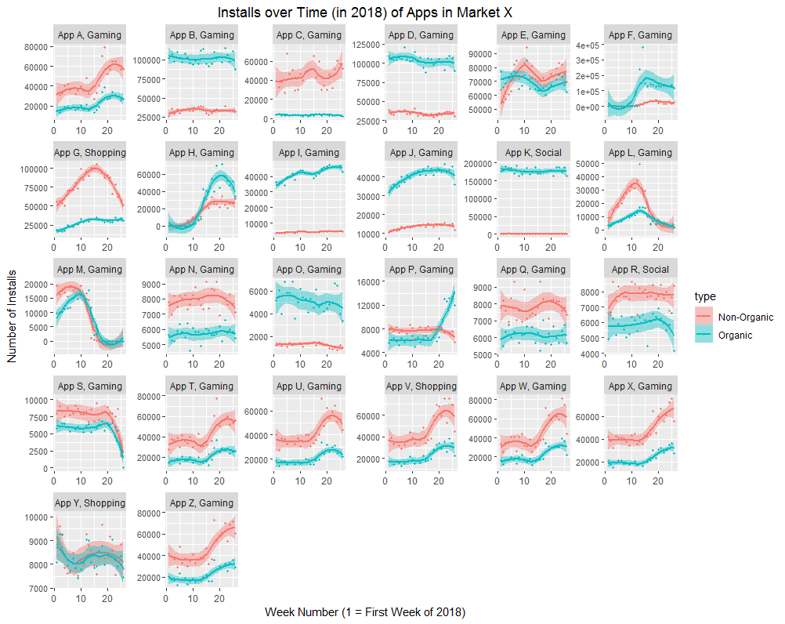
The Market as a Whole in 2018
We see that in the first half of 2018, Market X had a healthy user base that was interested in Gaming, Social and Shopping Applications. The Market finds new apps through both Organic and Non-Organic Channels.
Special shoutout to the Social App K, the most installed app in Market X with ~89,000 weekly installs on average (mostly organic)! This categorizes a viral social media app that is still new and does not yet rely heavily on Non-Organic channels.

Slide 3
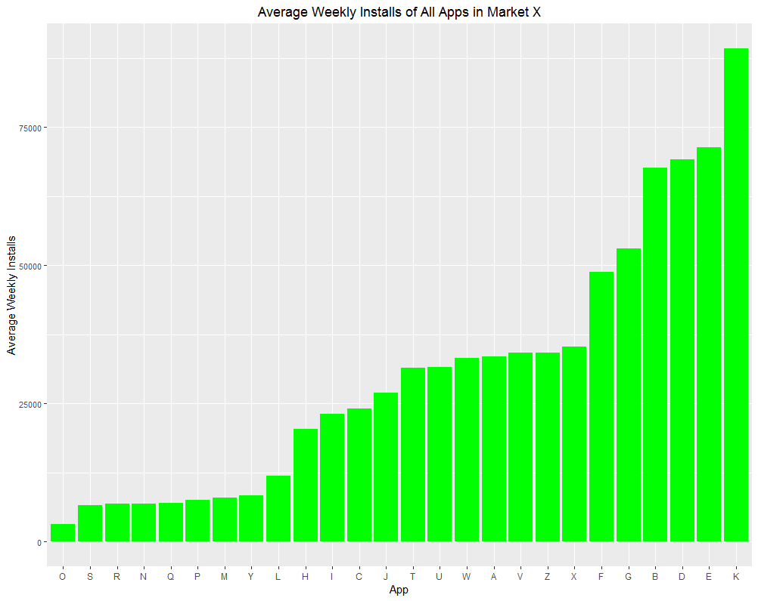
App A Performance vs. Market
Since we have data for the same time period for all apps, we can compare their average weekly installs (organic + non-organic) to analyse their performance
When considering all apps in the Market, we see that App A is 10th out of 26.
However, we need to compare “apples to apples” – not all Apps are in the same growth stage or compete for the same users that App A does…

Slide 4
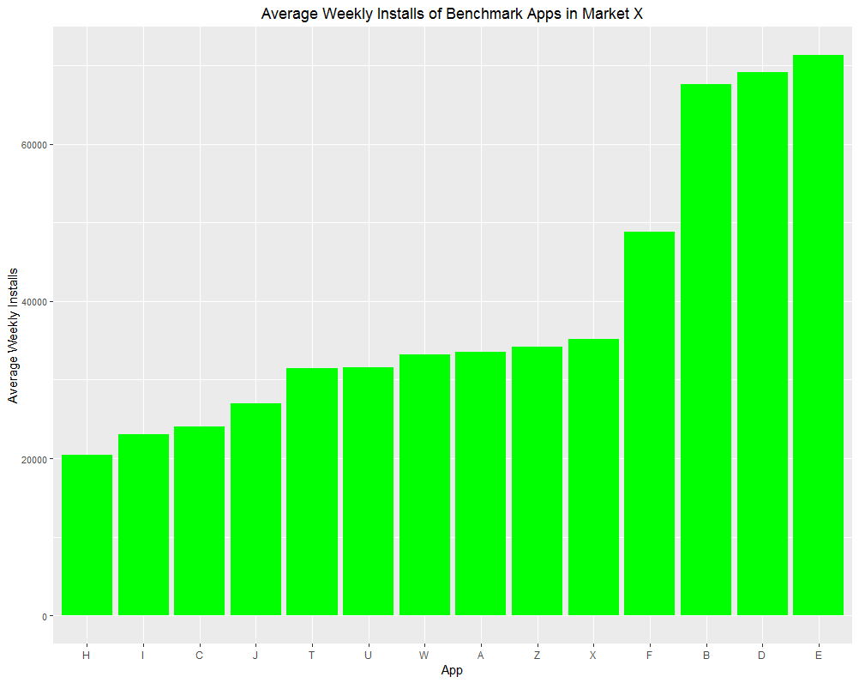
App A Performance vs. Benchmark
A benchmark of Apps related to App A was constructed using 2 criteria:
App must be Gaming related
App must have at least 20,000 weekly installs on average (to exclude apps that do not have the same magnitude of popularity)
We now see that App A is 7th out of 14 Apps in the Benchmark – right in the middle!
App E, D, B and F lead the pack in this Gaming Benchmark.

Slide 5
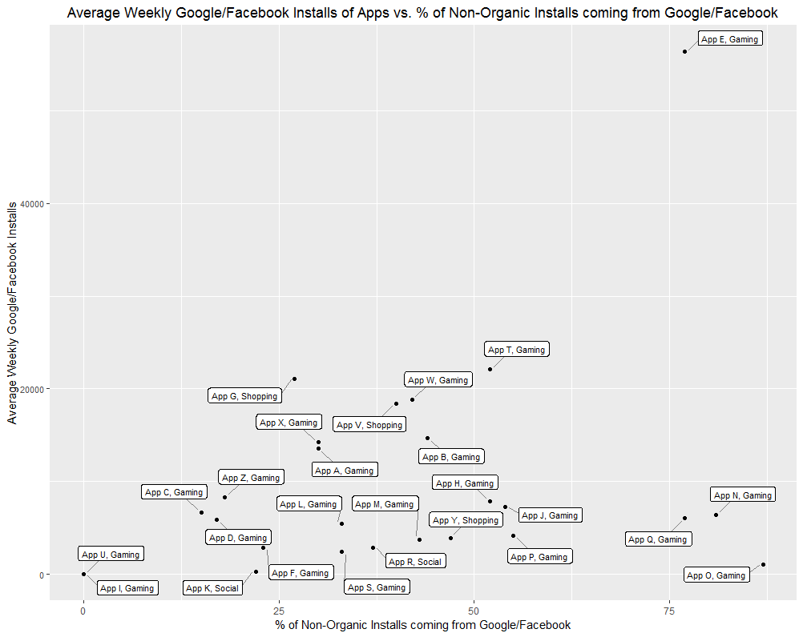
Using FB/Google to drive Non-Organic Installs
Different apps use Facebook depending on: the type of app (multiplayer game vs. single-player), target audience (Snapchat has a younger demographic than FB) and ad spend budget.
In the absence of ad spend numbers, we can examine the % of Non-Organic Installs coming from Google/FB, which tells how important these platforms are in an app’s non-organic strategy.
App A has a factor of 30%, which means Facebook has the potential to become a more dominant portion of Non-organic strategy for A. This only makes sense if App A can increase FB installs similar to App W, App T and especially App E.

Slide 6
The “Jump” of May
For Gaming Apps A, T, U, W, X, we see an eerily similar “jump” in both Organic and Non-Organic installs that originates in May and sustains into June.
The users of Market X were influenced by an external event that increased their desire to engage with certain games. One reason could be the start of summer break for students, who are looking for fun games to enjoy during their newfound spare time.

Slide 7
Recommendations for App A
App A has the potential to improve both Organic and Non-Organic performance to become the dominant Gaming app in Market X and overthrow App E.
A possible way to increase Organic installs is to mimic how App F increased their Organic presence considerably in the beginning of 2018. It would also be useful to analyse the existing, efficient organic strategies of App B and D. This could be referral link incentives, word-of-mouth, etc.
Increasing Facebook and Google ads only makes sense if there is a possible return. If App A can emulate the FB/GOOG strategy and success of App E, it would be worthwhile to consider increasing the usage of Facebook ads. This could be targeting ads in certain groups, changing the age demographic targeted, etc.
An alternative strategy to appeal to the local market could be to advertise on the Social App K. With a high organic user base, App K users might be interested in playing App A!

Slide 8
Future Analysis
To analyse the performance of App A even further, it would be great to know how much each App has spent on each of their Non-Organic Channels (an App with small FB ad spend and a high count of FB installs could stand to gain way more users by increasing their FB ad spend)
It would also be helpful to know the Cost of Acquiring a Customer for each App, and the app-specific Return on Ad Spend for each of the different channels each App uses. An app with high ROAS on Google Ads should focus on more Google Ads to drive their Non-Organic Growth.
A measure of an app’s “virality” could also be useful – how many times they are mentioned on Twitter, how many times they are shared with Referral links to other users, etc. This information could be used to identify apps with strong viral strategies that App A could emulate.

Slide 9



Thanks!

